Slide 1

Digital Estate Planning
In the case of your eventual demise
Consent to take photos or video of presentation is given by both presenters
Notes:
Play: https://www.youtube.com/watch?v=B9FzVhw8_bY 6 minutes before
Play: https://www.youtube.com/watch?v=2wC2jOSj8xU
play 3 minutes before

Slide 2

whoami
Kentucky (Lexington)
Security Operations Center Manager
Been doing this for awhile
CISSP, GCCC, CEH, CNDA, PMP
Also an OIF/OEF vet, runner, traveler, beer & bourbon snob
Twitter: @KyCarla

Slide 3

whoami
Matt Speer
Penetration Tester in the airline industry
15 years in Cybersecurity in both Blue Team and Red Team roles
○CISSP, CEH, GPEN, GCIH, etc
I play a lot of video games and travel but mostly a lot of video games

Slide 4
what we are going to talk about
Why it’s important for you and your family
Best practices based on experience & research
Cryptocurrency regulations and best practices
Digital Property best practices

Slide 5
the basics
Digital assets - electronic records that you own, control or license
Make a digital asset inventory
What do you want to be seen or controlled and by whom
Financial vs Sentimental
Instruction for how to handle various accounts
What to take down and want to memorialize
Password vaults
Work vs. Personal
Notes:
Digital assets include online photo and video collections, electronic records, email, social media accounts, cryptocurrency and frequent flyer miles. Because our digital assets are virtual in nature, an executor is not going to find them in a search of our home office. We have to leave instructions on what we have and how the executor is going to access it.
Just like Security, the first, and often hardest step, is creating an inventory of your assets. Most digital assets are going to fall into one of two categories. Either they have financial value or Sentimental value. Then decide what you want done, either transferred, memorialized, or deactivated. Don’t forget to make note of what you don’t want seen or accessed and come up with a plan for that.
Remember to include access to your devices and accounts. This is mostly easily done through password vaulting. I recommend having two separate vaults. For myself, I put all my work accounts in KeePass. No one but me has access to that vault. For my personal and family accounts I use LastPass, and that’s what I’ll focus on in a minute.

Slide 6
the law, P.S. I’m not a lawyer
Until recently, very few laws helped to determine who could access these files and accounts if the user became incapacitated or died
The Revised Uniform Fiduciary Access to Digital Asset Act (RUFADAA)
The Act allows you to grant a fiduciary access to your digital accounts upon your death or incapacity, either by opting them in with an online tool furnished by the service provider or through your estate plan
Three-tiers for prioritizing access
Notes:
But first the Law.
Until very recently, there were no laws governing who could access your digital assets in the event of your incapacity or death. As a result, if you died without leaving your loved ones your usernames or passwords, the tech companies who controlled the platforms housing the assets would often delete the accounts or leave them sitting in a state of online limbo, inaccessible to your family and friends.
This gaping hole in the legal landscape caused considerable heartbreak for families looking to collect their loved one’s digital history, and it caused major frustration for the executors and trustees charged with cleaning up the estate—it also led to the loss of an untold amount of both tangible and intangible wealth. The federal government finally stepped in to find a solution for this problem and in 2015 passed the Uniform Law Commission passed the Uniform Fiduciary Access to Digital Access Act (UFADAA).
This Act allows you to grant a fiduciary access to your digital accounts upon your death, and lays out specific guidelines under which fiduciaries, such as executors and trustees, can access your digital assets.
he Act offers three-tiers for prioritizing access. The first tier gives priority to the online provider’s access-authorization tool for handling accounts of a decedent. For example, Google’s “inactive account manager” tool lets you choose who can access and manage your account after you pass away. Facebook has a similar tool that allows you to designate someone as a “Legacy Contact” to manage your personal profile.
If an online tool is not available or if the decedent did not use it, the law’s second tier gives priority to directions given by the decedent in a will, trust, power of attorney, or other means. If no such instructions are provided, then the third tier stipulates the provider’s TOSA will govern access.
The bottom line: If you use the provider’s online tool—if one is available—and/or include instructions in your estate plan, your digital assets should be accessible per your wishes in most every state under this law. However, it’s important that you leave your fiduciary detailed instructions about how to access your accounts, including usernames and passwords, because without such information, your executor or trustee won’t be able to even access, much less manage, your digital assets if something happens to you.

Slide 7
one example: Kentucky law
395A.040 User direction for disclosure of digital assets.
(1) A user may use an online tool to direct the custodian to disclose to a designated recipient or not to disclose some or all of the user's digital assets, including the content of electronic communications. If the online tool allows the user to modify or delete a direction at all times, a direction regarding disclosure using an online tool overrides a contrary direction by the user in a will, trust, power of attorney, or other record.
(2) If a user has not used an online tool to give direction under subsection (1) of this section or if the custodian has not provided an online tool, the user may allow or prohibit in a will, trust, power of attorney, or other record, disclosure to a fiduciary of some or all of the user's digital assets, including the content of electronic communications sent or received by the user.
(3) A user's direction under subsection (1) or (2) of this section overrides a contrary provision in a terms-of-service agreement that does not require the user to act affirmatively and distinctly from the user's assent to the terms of service. Effective: July 15, 2020 History: Created 2020 Ky. Acts ch. 63, sec. 3, effective July 15, 2020.
Notes:
Here is an example of the Kentucky statute for user direction for disclosure of digital assets. One thing id do want to point out is that a direction regarding disclosure using an online tool overrides a contrary direction by the user in a will, trust, power of attorney, or other record.
So for example, I have my daughter listed as my “legacy Contact” for Facebook. She takes control of my account when I die. But in my Trust, I have my digital assets assigned to my husband. Everything else will go to him, but my Facebook account.

Slide 8









what about all those sites?
Facebook: Decide if you want your account deactivated, deleted, or memorialized. If you choose to have your account memorialized, appoint a legacy contact to manage it.
Pinterest: Have someone deactivate your account
Online Dating: Have someone contact the site and close online dating accounts
Google: Through the “Inactive Account Manager,” choose a “trusted contact” to receive whatever data you choose to leave them. You may also choose to delete all your data. This includes Google products and subsidiaries: Google+, Blogger, Drive, Mail, Picasa, YouTube
Yahoo: Have someone contact Yahoo and request your account be deleted, this includes Yahoo properties such as Flickr and Tumblr
Twitter: Have someone notify Twitter and deactivate your account, including Vine account, if you have one.
Instagram: Decide if you want your account to be memorialized. Have someone contact Instagram
Wordpress: have someone contact Wordpress and decide what you want them to do -- keep your blog or take it down. Other blogging sites may have other rules. Contact them to be sure
Linkedin: Decide if you want your account deleted or memorialized.
Notes:
Here is just an example of the different sites and the options you have. Now this is just 9 examples. The average person has 100 passwords.
Another thing to note, Although you might not know it, you don’t own many of your digital assets at all. when you purchase some digital property, such as Kindle e-books and iTunes music files, all you really own is a license to use it. And in many cases, that license is only for your personal use and is non-transferable.

Slide 9
some other things to think about
Streaming services
It’s a utility
Who do you share them with?
Multifactor Authentication
Who has your passcode?
Set up multiple authentication options
Domains
How to transfer ownership
Frequent Flyer and rewards programs
unofficial way around the rules as well as an official appeal process
Sock accounts?
Maybe, maybe not?
give it to me
Notes:
Well what about all the other stuff. Unfortunately, to get into the meaty stuff of crypto and gaming, I just want to point out that there are indeed other things to think about and most of you were probably already thinking about that. Leave your passcode to your phone for someone. I know I have a few accounts I’ve been able to set up multiple authentication types for, but it’s not universal.
Another interesting one is Frequent Flyer and Rewards programs.

Slide 10
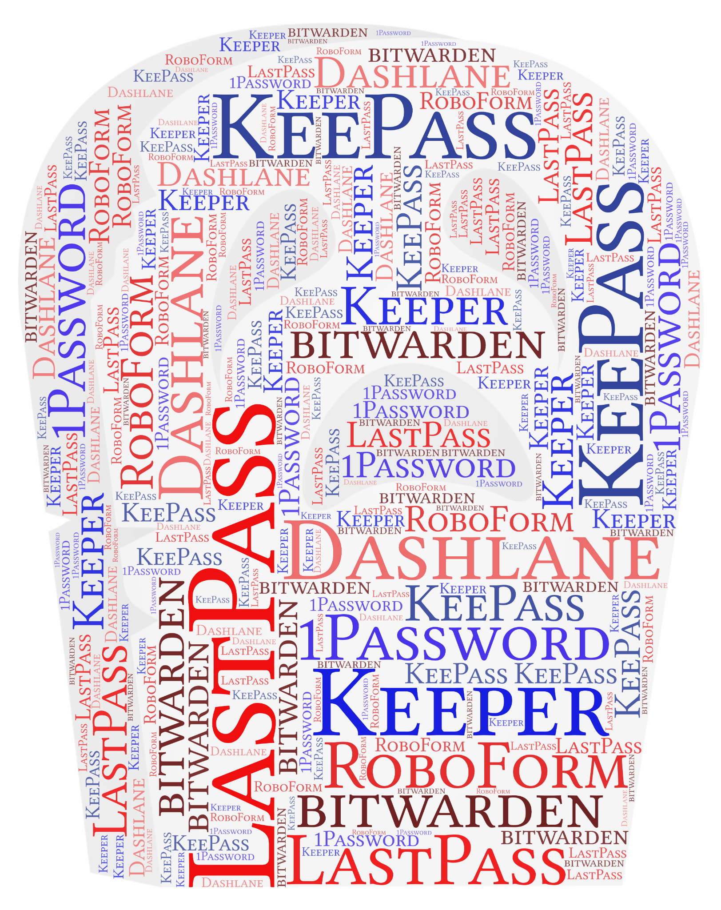

password vaulting
Do it for your family
Average number of accounts
Social media - 8.8 per person
100 passwords on average
Which password manager to use
Home
Secure your digital legacy
Work
Gotta keep ‘em separated
Notes:
A new study suggests the reason for this could be that we're each juggling 100 passwords across various sites and services.
The most useful digital legacy planning aspect of LastPass is the Emergency Access facility. The Emergency Access feature gives trusted family and friends access to your LastPass account in the event of an emergency or if you die. Your designated Emergency Access contact(s) can request access to your account. They securely receive the passwords and notes without knowing your Master Password. You decide how much time should pass before giving access. If they request it, you can decline access if unnecessary. If you were to die this facility alone could save so many problems for your loved ones.

Slide 11
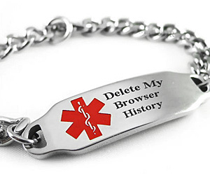

Slide 12
the not so basics of life in a digital world
Cryptocurrency
Gaming assets

Slide 13
the not so basics
Life is complicated and we accumulate stuff.
“He who dies with the most toys still dies”
We have to dispose of digital accumulations

Slide 14
cryptocurrency
Estate Planning When You Own Cryptocurrency:
https://www.forbes.com/sites/matthewerskine/2020/07/30/estate-planning-when-you-own-cryptocurrency/?sh=7fb507de871b
Trusts and other planning devices have a hard time owning cryptocurrency, especially if the Prudent Investor Rule applies. Without specific language, the trust will not be able to hold cryptocurrency, but if that language is written too broadly, the trustee may be exempt from damages due to willful neglect. Also cryptocurrency is tax as property rather than as currency by the IRS for tax purposes.

Slide 15
cryptocurrency
How do you pass on your digital wallet?
Cryptocurrency is still the wild west in terms of legality and general understanding by the public.
Make sure your power of attorney or estate executor has your recovery codes and understand how to access your crypto wallet. Take the time to educate for their benefit.

Slide 16

gaming assets
I play a terrible game that no one should ever play: Eve Online.
Eve is a unique game in that digital assets can be passed on to others, bought, traded, and sold. Digital assets that are destroyed in game are lost forever.
My personal assets within the game are worth 15k USD in terms of real dollars and include some of the largest and rarest ships in the game.

Slide 17
Some final (heh)...thoughts
Make sure your will clearly delineates what should be accessed and what is taken to the grave
Be diligent and plan ahead
Take the time to list your digital assets and update it as necessary

Slide 18

Remember, none of us get out of this alive
What are your Questions?

